Slide 1




Course name: engineering mathematics-iII
B.TECH SECOND YEAR
Academic YEAR: 2020-2021
Course code : ma 2101
lecture series no : 13
Credits : 3
Mode of delivery : online (Power point presentation)
Faculty : Dr. GARIMA AGARWAL
Email-id : garima.Agarwal@jaipur.manipal.edu
PROPOSED DATE OF DELIVERY: 16 OCTOBER 2020

Slide 2

Session outcome
“Application of graph theory using two important graphs ”

Slide 3
Assessment criteria's
Assignment
quiz
mid term examination –I & II END TERM EXAMINATION

Slide 4

PROGRAM OUTCOMES MAPPING WITH CO2
[PO1]
Engineering Knowledge: Apply the knowledge of mathematics, science, engineering fundamentals, and an engineering specialization to the solution of complex engineering problems.

Slide 5
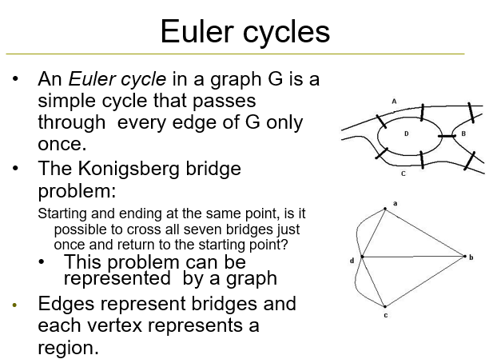
Session outcome
“ To understand the concept of ode and their applications and solve the problem”

Slide 6
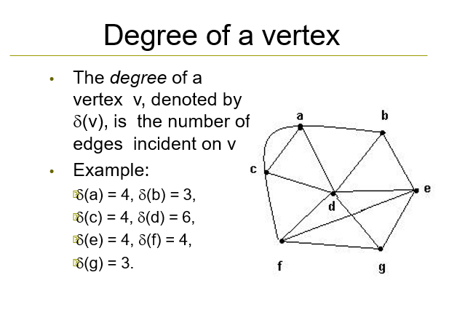
Session outcome
“ To understand the concept of ode and their applications and solve the problem”

Slide 7
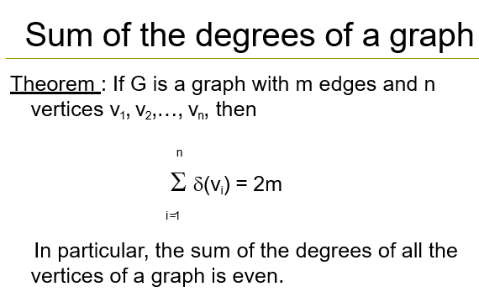
Session outcome
“ To understand the concept of ode and their applications and solve the problem”

Slide 8
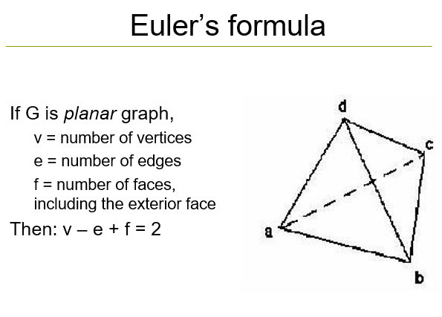
Session outcome
“ To understand the concept of ode and their applications and solve the problem”

Slide 9
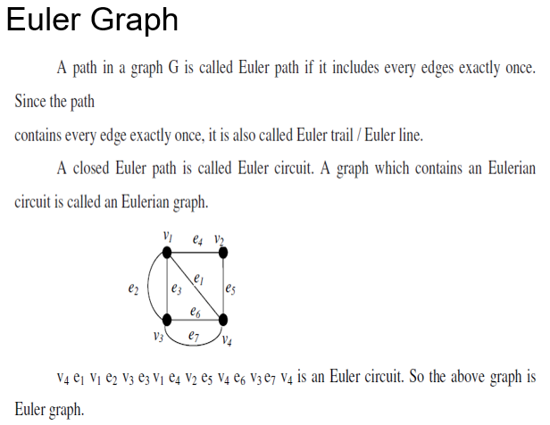
Session outcome
“ To understand the concept of ode and their applications and solve the problem”

Slide 10
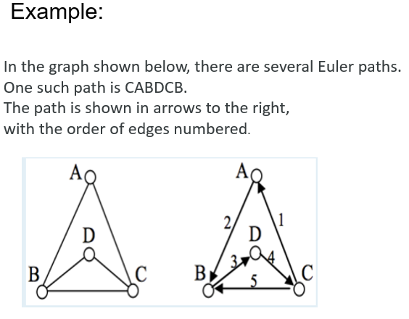
Session outcome
“ To understand the concept of ode and their applications and solve the problem”

Slide 11
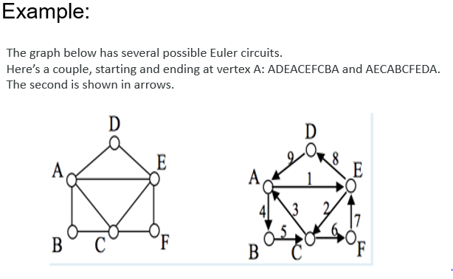
Session outcome
“ To understand the concept of ode and their applications and solve the problem”

Slide 12
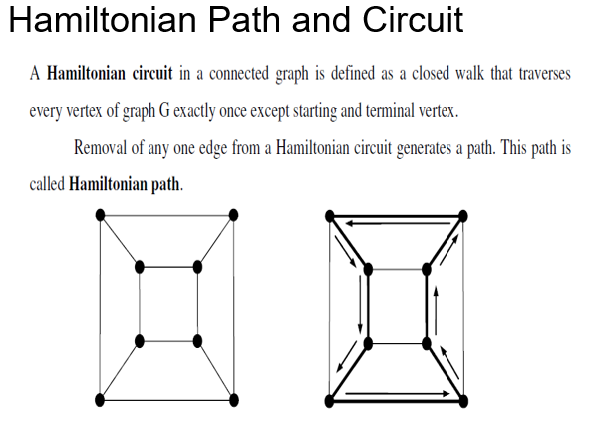
Session outcome
“ To understand the concept of ode and their applications and solve the problem”

Slide 13
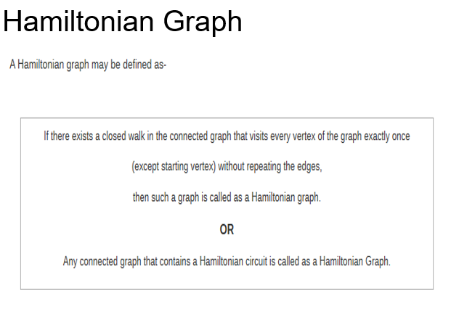
Session outcome
“ To understand the concept of ode and their applications and solve the problem”

Slide 14
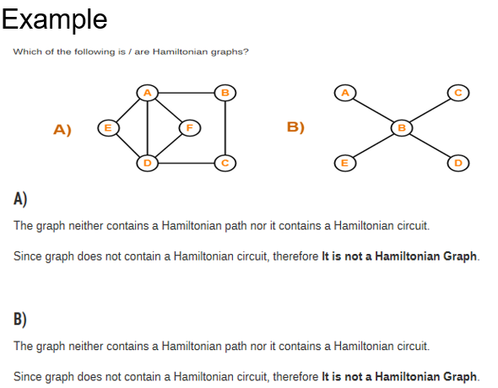
Session outcome
“ To understand the concept of ode and their applications and solve the problem”

Slide 15
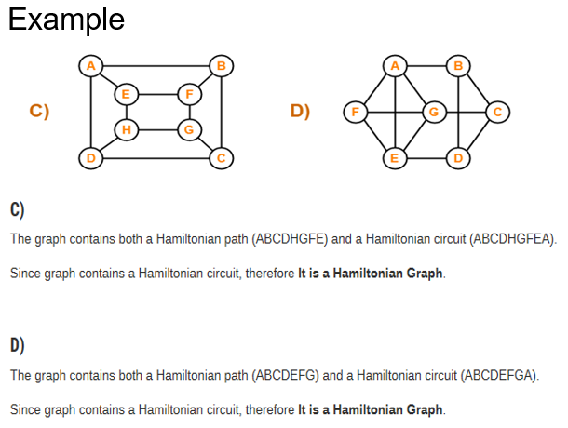
Session outcome
“ To understand the concept of ode and their applications and solve the problem”

